Slide 1

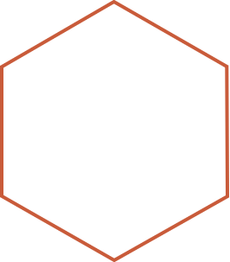

Visualización Intro a ggplot2
Sesión 2:
Ricardo Ahumada Oliva
Unidad de Planificación Sanitaria y ED.
Departamento de Gestión de Redes - DSSMS

Slide 2
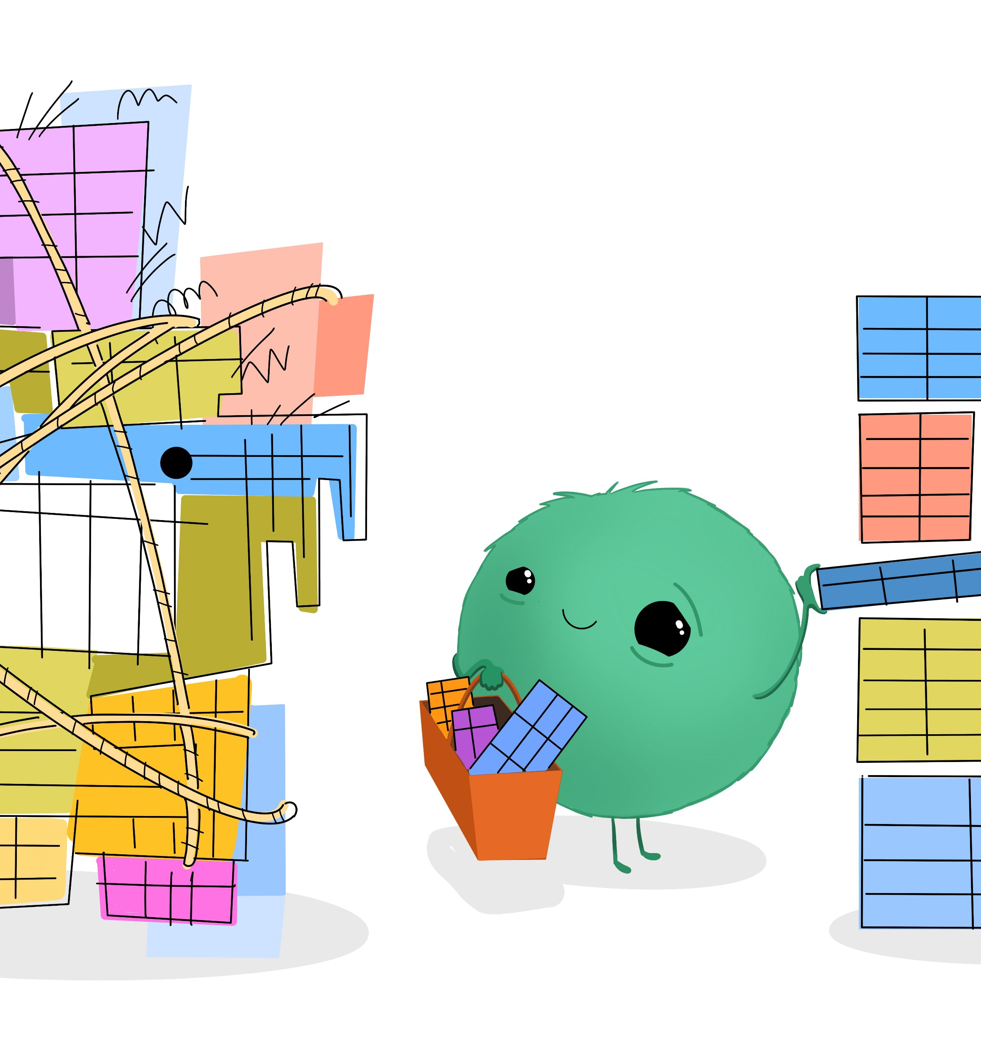
Recap
2

Slide 3
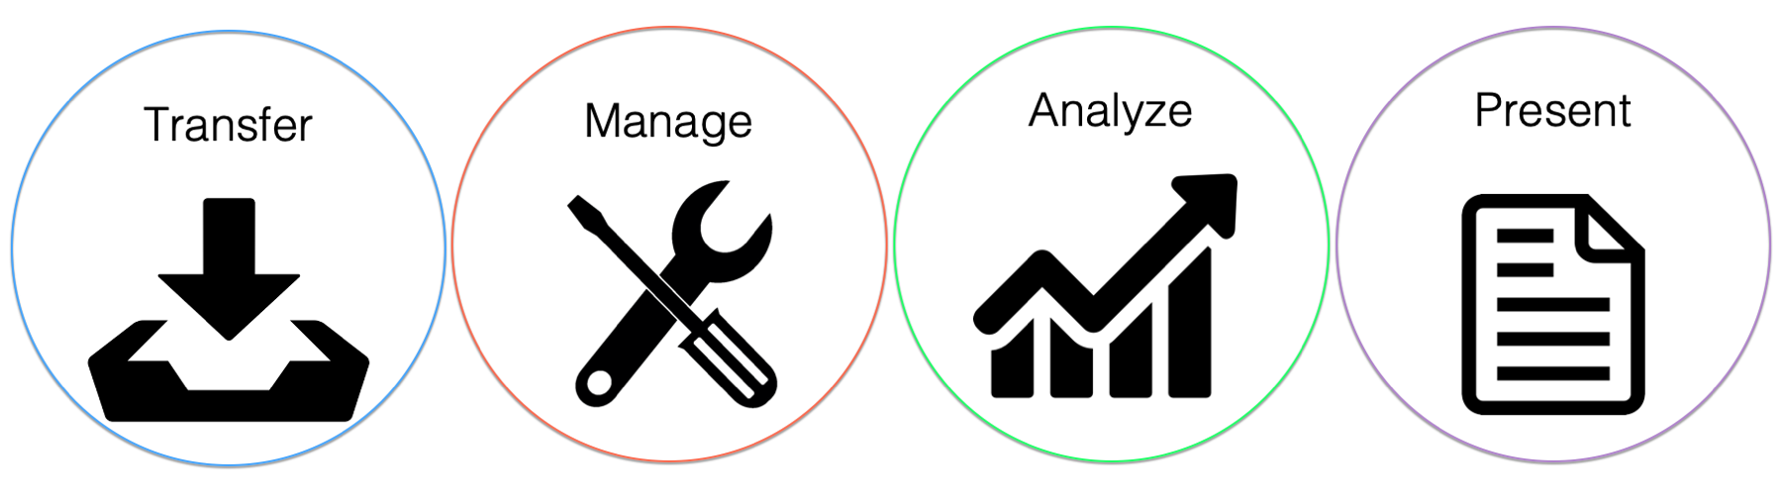
Recap

Slide 4
Librerías para análisis de datos
4

Slide 5
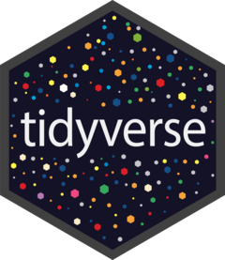

Slide 6
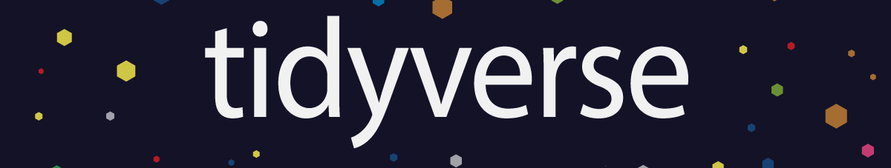




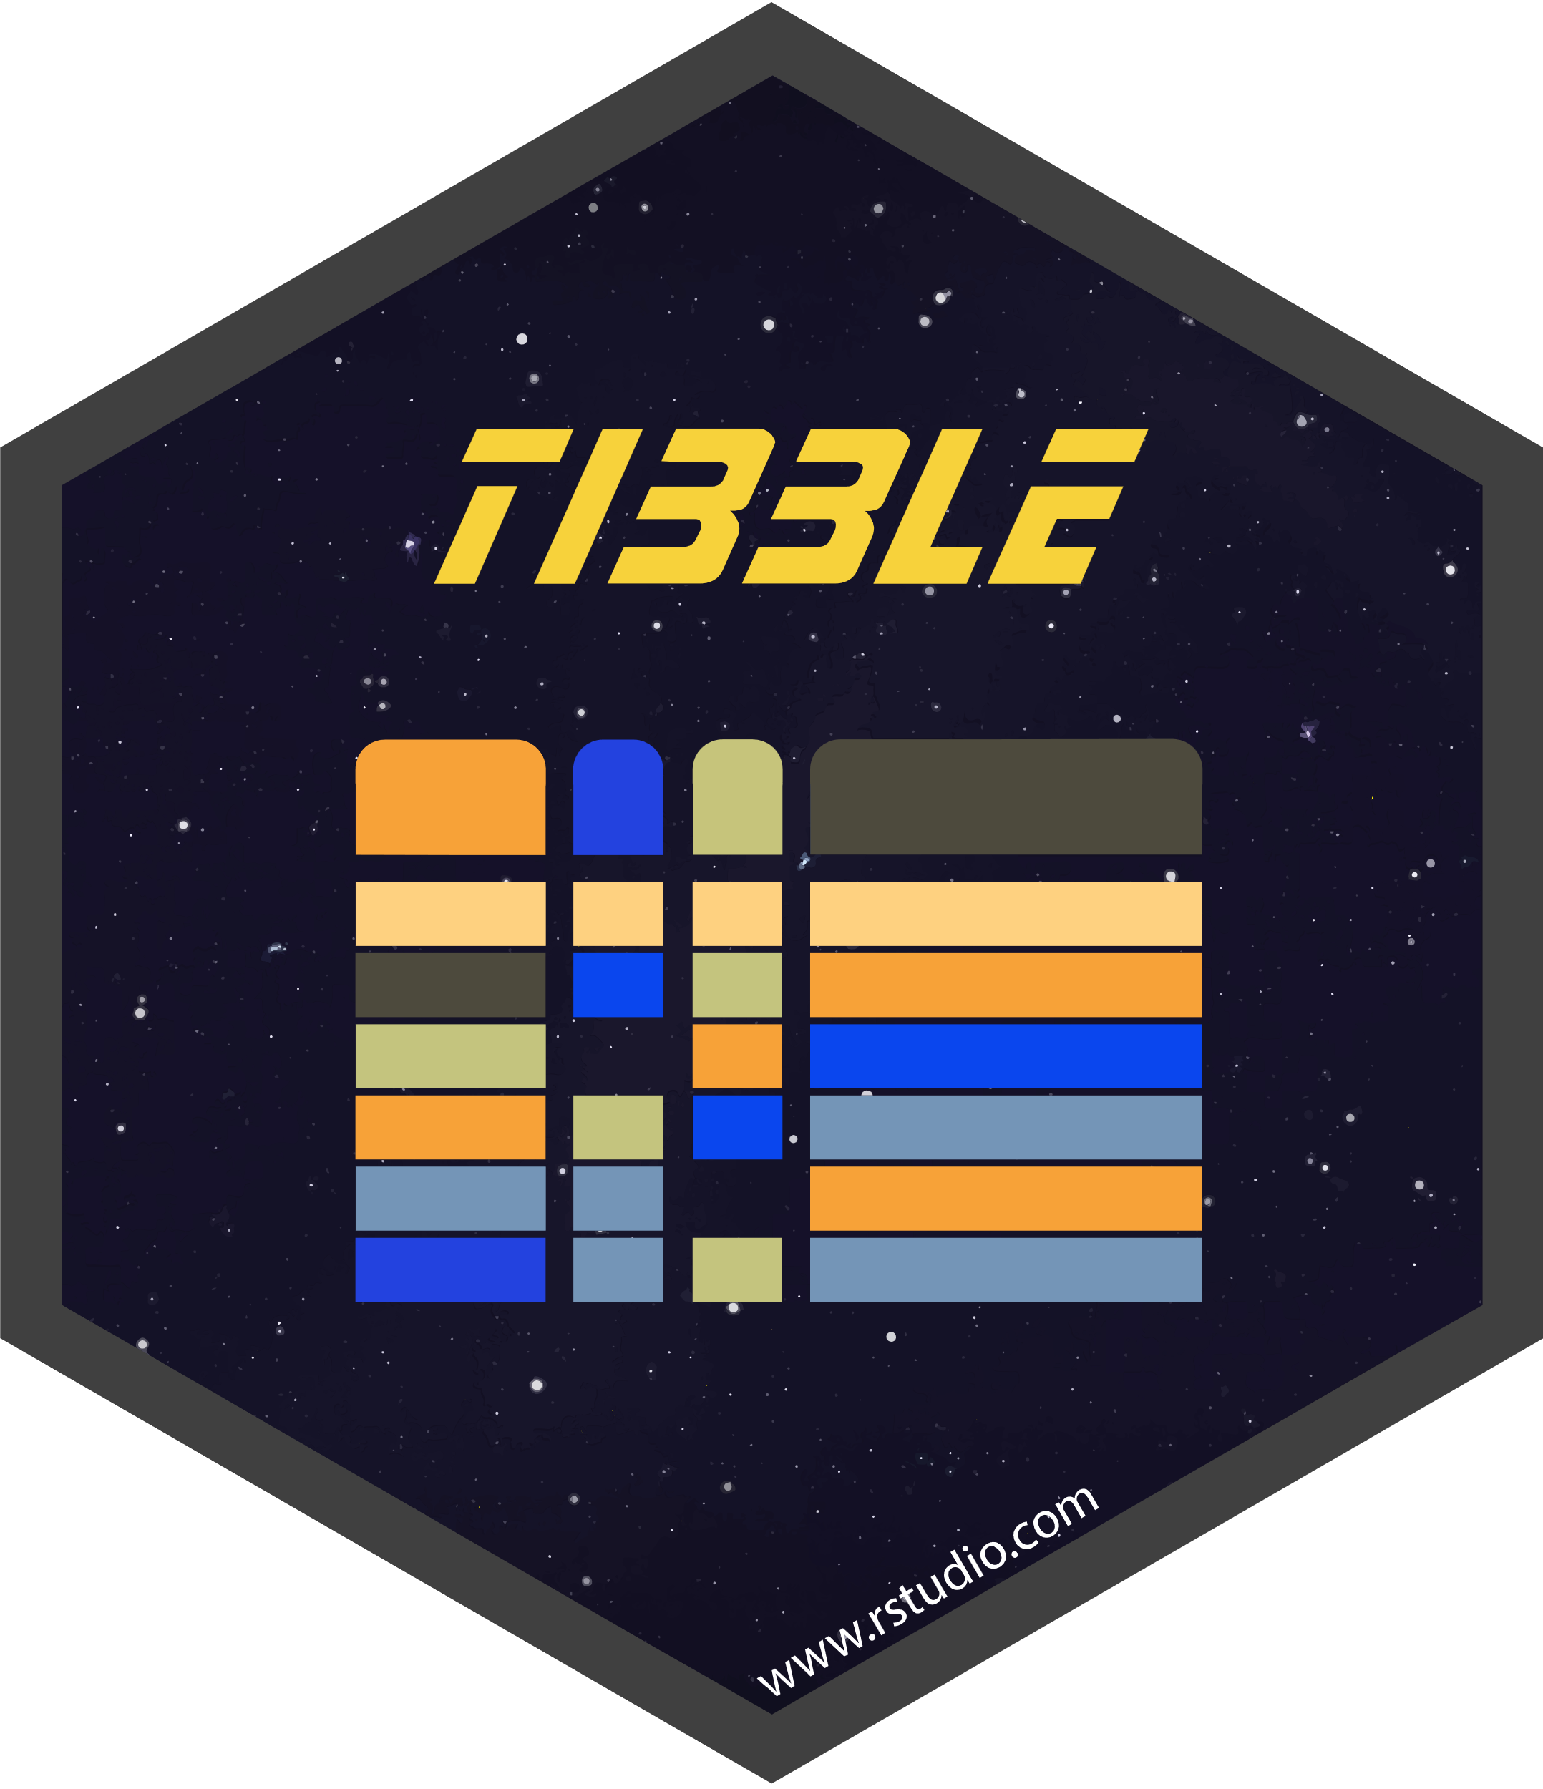


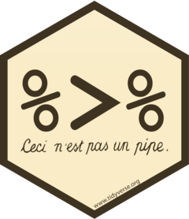


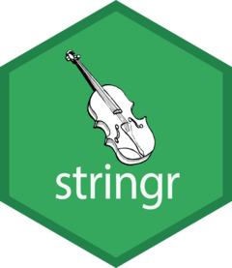
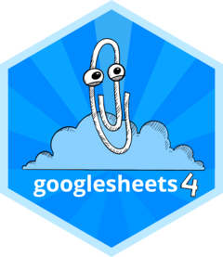
https://dplyr.tidyverse.org/
https://purrr.tidyverse.org/
https://github.com/tidyverse/forcats
https://haven.tidyverse.org/
https://tibble.tidyverse.org/
https://github.com/tidyverse/lubridate
https://readr.tidyverse.org/
https://magrittr.tidyverse.org/
https://readxl.tidyverse.org/
https://tidyr.tidyverse.org/
https://github.com/tidyverse/stringr
https://googlesheets4.tidyverse.org/

Slide 7
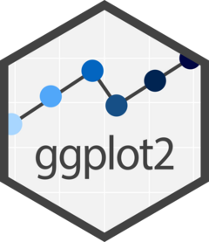
Visualización
https://ggplot2.tidyverse.org/
7

Slide 8
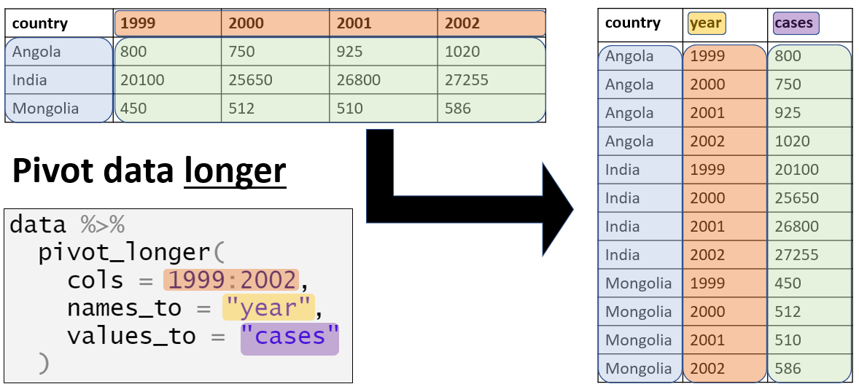
Pivotear los datos

Slide 9
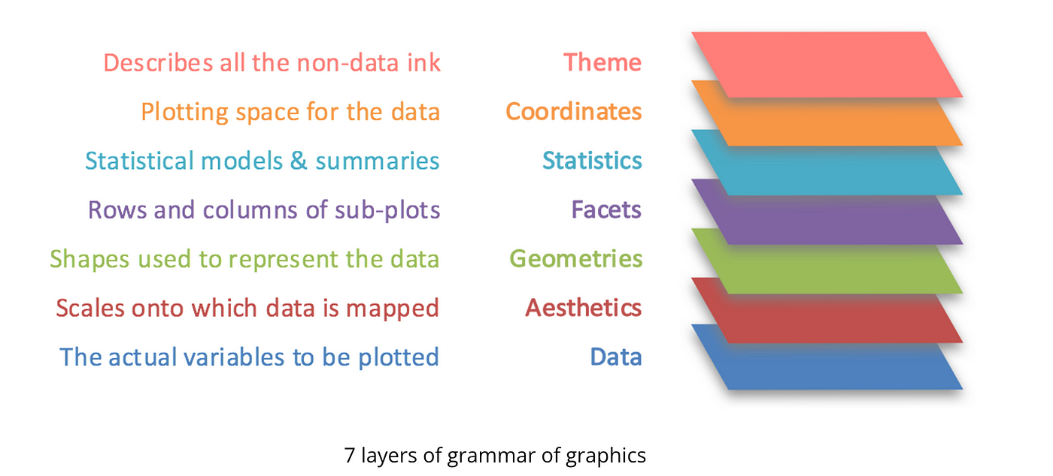
“Gramática de los gráficos” en ggplot2

Slide 10
Element | Description
Data | This is the dataset being plotted containing the variables to be plotted on the graph. This is an essential element.
Aesthetics | Aesthetics refers to the scales on which we map our data. For example, we will map one variable to the x-axis, and another to y-axis. We may use to differentiate different attributes by color. Some common aesthetics to consider are axis, shape, size and color. This is an essential element.
Geometries | Geom refers to the actual visual elements used for the data in the plot, such as points, lines, and bars. This is an essential element.
Facets | Faceting refers to splitting the data into multiple subsets and then displaying plots for the specific subsets in a panel. Such plots are also called small-multiple plots. The facet approach partitions a plot into a matrix of panels. Each panel shows a different subset of the data. This is an optional element.
Statistics | This refers to representing statistical information about the data, such as mean and variance, to help in understanding the data. This is an optional element.
Coordinates | This refers to the space on which the data is plotted (E.g., Cartesian coordinates). Most popular graphs such as line and bar charts are drawn using Cartesian coordinates. This is an optional element.
Themes | Themes are used to change the appearance of non-data elements. Themes enable you to design with a particular visual identity using fonts, colours and other design elements. This is an optional element.

Slide 11
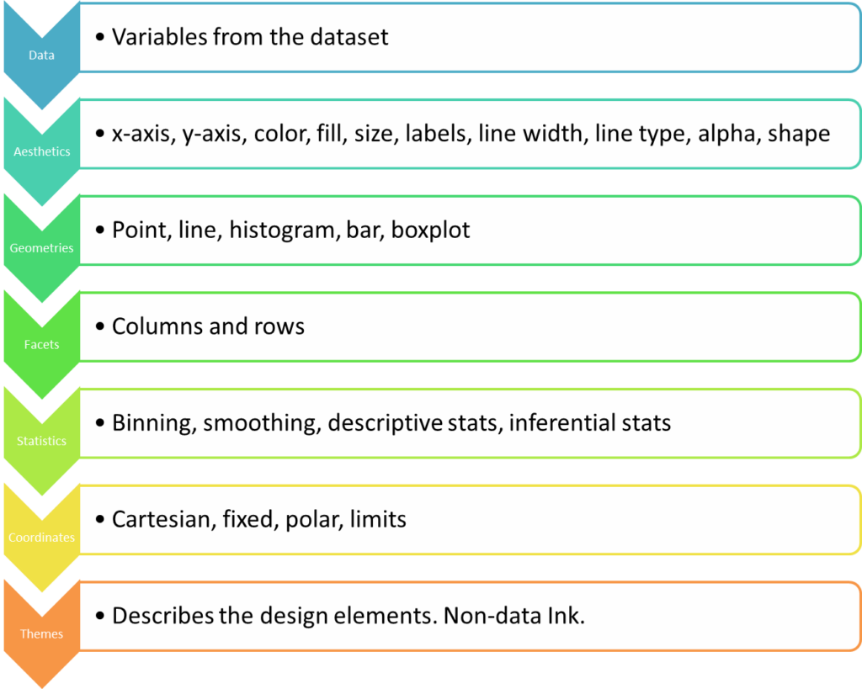
“Gramática de los gráficos” en ggplot2

Slide 12
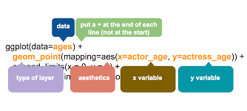
“Gramática de los gráficos” en ggplot2

Slide 13
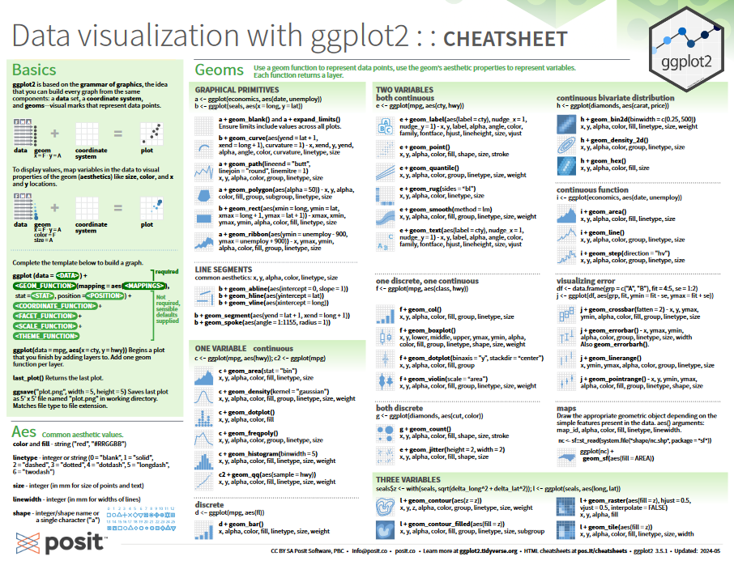
Cheat sheets

Slide 14
Gracias

